Slide 1
Visual Intelligence System
Deepa Bhandari (140336) Rohan Baidya (140335) Punita Kushwaha (140316) Deepak Shah (140328)

Slide 2
What is VIS?
A Generic System that mimics Human Visual System in a way by:
applying ‘Computer Vision’
and implementing task as:
1. Visual (Pattern) Detection 2. Visual Recognition

Slide 3
Visual R
Computerized Automated System equivalent of Human Vision, i.e. to detect and identify.

Slide 4
What’s the Objective?
basically to optimize three fields of project:
QUALITY
COST
SCHEDULE

Slide 5
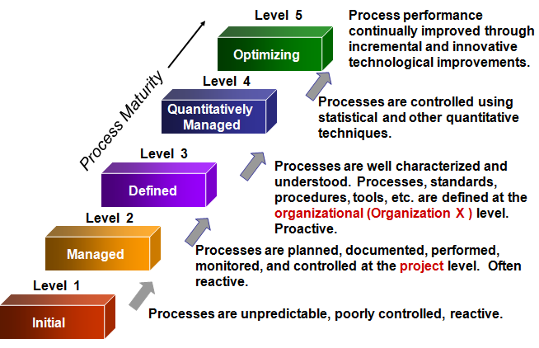
Levels of CMMI

Slide 6
LEVEL 0
aka “INCOMPLETE”
The cradle of development (Inception Phase)
Basic level where:
- requirement management
- goals & objectives
defined by CMMI for Level 1 are NOT achieved yet

Slide 7
LEVEL 1
aka “PERFORMED”
deals with performed processes which are:
- Unpredictable - Poorly controlled - Reactive
process performance may not meet specific objectives as:
- Quality - Cost -Schedule
YET useful work can be done.

Slide 8
LEVEL 2
aka “MANAGED” (LEVEL 1 Cleared)
Employ Skilled People w/ Resources Available
Stake holders are involved where PDP process are : (MCR-ed)
PDP: - Planned - Documented - Performed MCR: -Monitored -Controlled -Reviewed
Managed process are close to achieving specific objectives:
- Quality - Cost - Schedule

Slide 9
LEVEL 3
aka “DEFINED” (LEVEL 2 Cleared)
Processes are more:
- managed -understood -deployed -executed
across entire organization.
Proactive and major portions of organization can’t “opt out.”

Slide 10
LEVEL 4
aka “QUANTITATIVELY MANAGED” (LEVEL 3 Cleared)
Processes are improved and controlled using:
-Measurement - Quantitative Assessment
Greater sense of teamwork and inter-dependences.

Slide 11
LEVEL 5
aka “OPTIMIZED” (LEVEL 4 Cleared)
Focus on :
- Continuous Quantitative (Statistical) Improvement
- Improvement Anticipated
- Impact Assessed
Optimized using statistical method to: - meet alteration in customer’s need.

Slide 12
The People CMM
Used in “Workforce Development”
- approach to economic dev and stability by focusing on people.
Developed in between 1990s and improvised thereon.
Maturity framework focusing on continuously improvising: - Management - Development of Human asset of Organization

Slide 13
GOAL of People CMM
Encourage generic workforce knowledge
Develop Software Engineering Skills
Develop Project Management Skills

Slide 14
WHY P-CMM?
People is one of the main aspect of organization
Too much focus on technology and less on people
Consideration on not aspect of whole person

Slide 15
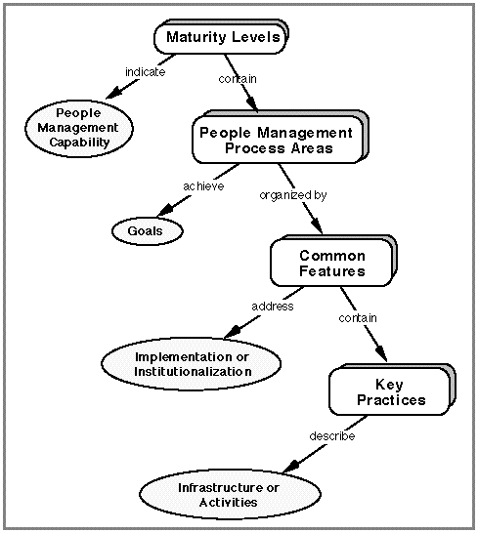
The People CMM (PCMM)

Slide 16
LEVEL: INITIAL
The software process is characterized as ad hoc
And occasionally even chaotic
Few processes are defined
Success depends on individual effort.

Slide 17
LEVEL: MANAGED
Focused on: Basic people management practices
Tracks: - Cost - Schedule - Functionality
The necessary steps placed to repeat earlier successes on projects with similar applications.

Slide 18
LEVEL: DEFINED
The people are managed and engineering activities are:
- Documented - Standardized - Integrated into a standard software of organization
Use an approved, tailored version of the organization’s standard method for:
- Development - Maintenance

Slide 19
LEVEL: PREDICATABLE
People are: - Quantified - Managed according to skill, knowledge and ability
i.e. Predicts user trend and their capability
Implementation can be in: -Organizational Capability Mgmt -Performance Mgmt

Slide 20
LEVEL: OPTIMIZED
Continuous process improvement is enabled by: - quantitative feedback
- piloting innovative ideas and technologies.
Implementation can be: - Continuous capability - Performance alignment and improvement

Slide 21
SUMMARY
Initial: Ad-hoc people management
Repeatable: Policy dev for capability improvement
Defined: Standardize people mgmt across org
Managed: Quantitative goal for people mgmt.
Optimizing: Improving individual competence workforce motivation.

Slide 22
THANK YOU

